Slide 1
EDA Cab Investment
Zain Ul Haq
Group ID:LIAUM07
Data Glacier Internship

Slide 2
Background
XYZ is a private equity firm in US. Due to remarkable growth in the Cab Industry in last few years and multiple key players in the market, it is planning for an investment in Cab industry.
Objective: Provide actionable insights to help XYZ firm in identifying the right company for making investment.
The analysis will provide the information about the following:
Data Understanding
Forecasting Profit and number of users per each cab
Analysis for the most profitable company
Recommendation for Investment

Slide 3
Data Exploratory Analysis
19 Features( including 7 derived features)
Timeframe of the data: 2016-01-01 to 2018-12-31
Total data points : 359,392
Basic Assumptions:
Profits are calculated and only cost of trip and price charged features are used for calculating the profits of each cab company.
Users features of city dataset is used as number of cab users per city. But we also considered these are also other company users as well ( including Yellow and Pink Cab Company)

Slide 4
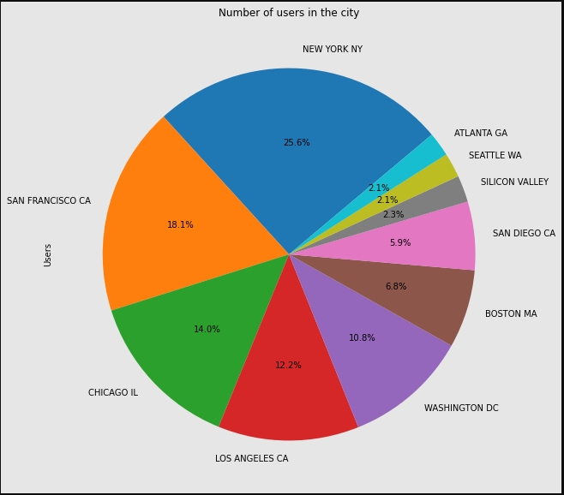
Cab Users Analysis in Cities
New York is the most populous city in terms of using Cab.
While, Chicago and San Francisco are other most populous cities in terms of using cabs a

Slide 5
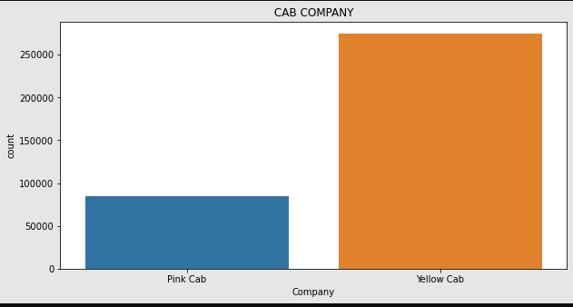
Users Preference in Cab Company
It’s shown that Yellow Cab Company is the most popular choice in travelling among users

Slide 6
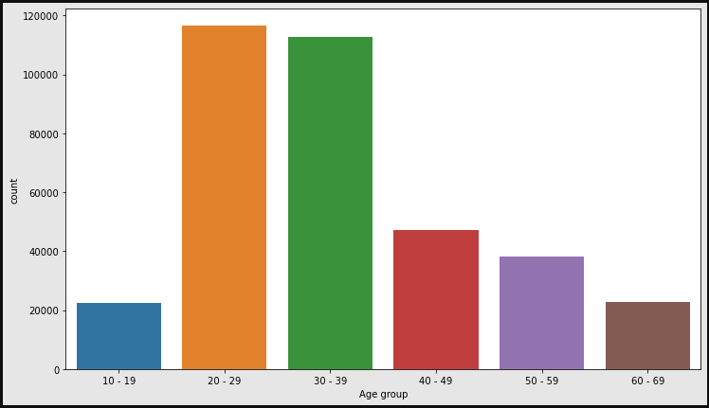
Profit Analysis Age Wise
Most user are in the age range of 20 -39
It’s evident in graph that yellow Cab company accumulates the more profit in each age group
Whereas, Pink Cab Company accumulates only a small proportion of profit.

Slide 7
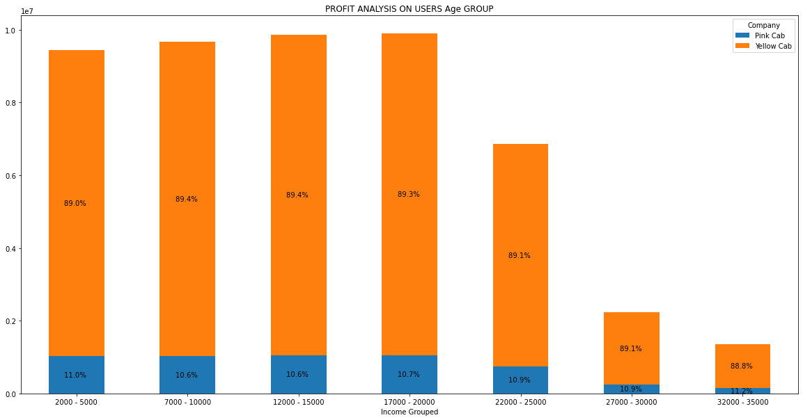
Profit Analysis Income Wise
Yellow cab company made more than 85% of profit in each income class in US

Slide 8
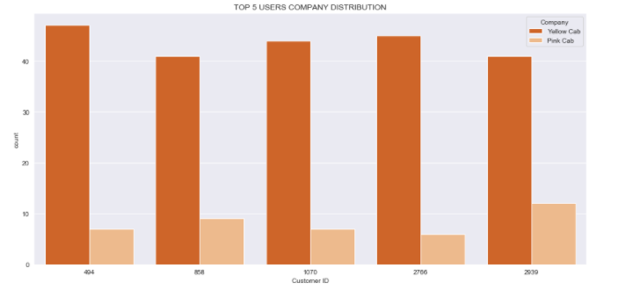
Top 5 Customers Analysis
The graph displayed the results of 5 top customers
In each 50 each rides from both company they all had prefers yellow cab company for their rides and very less amount of rides they had been taken with Pink can company

Slide 9
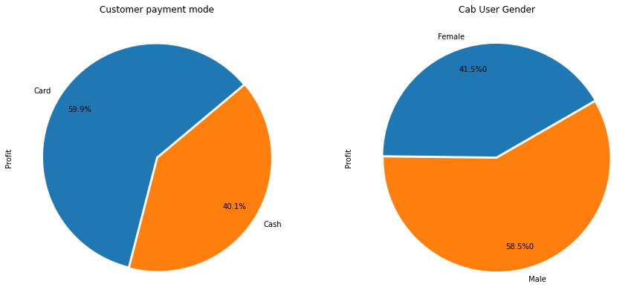
Profit Analysis Payment mode and Gender Wise
Most Cab users are Males with 58% and their preferred payment mode is Card which accumulates nearly 60%

Slide 10
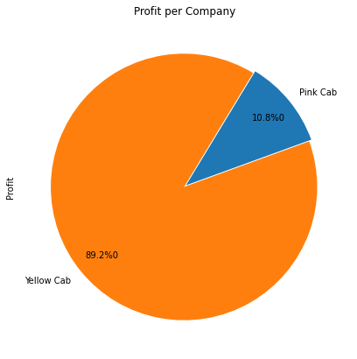
Profit Analysis
The results show yellow Cab company has the largest profit share.

Slide 11
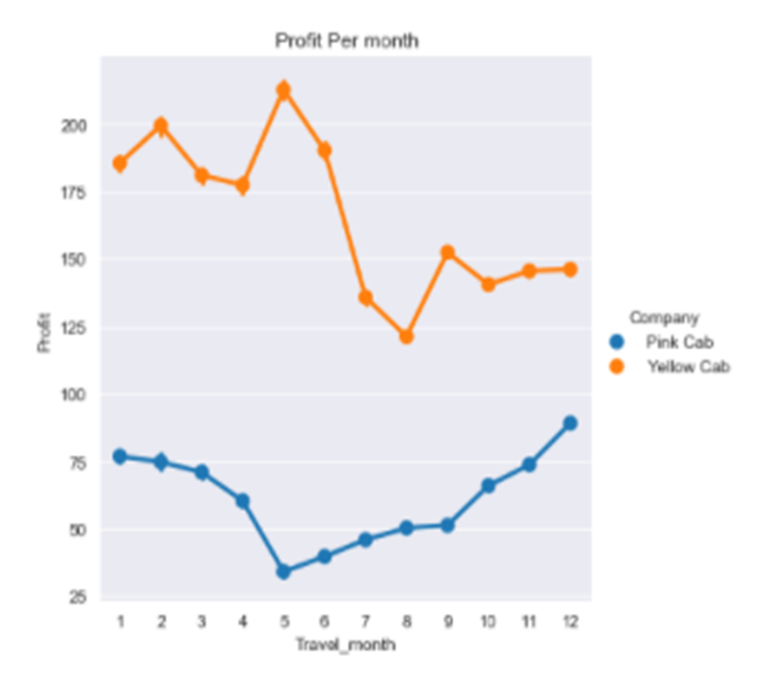
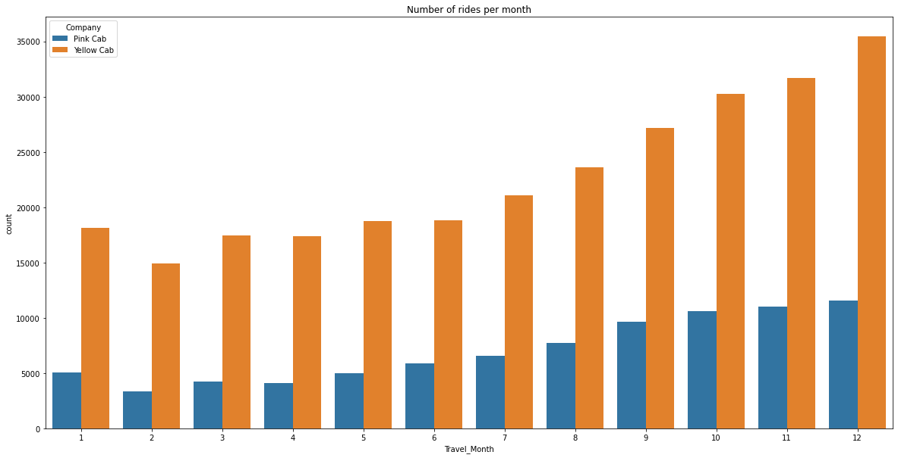
Month Profit and Ride Analysis

Slide 12
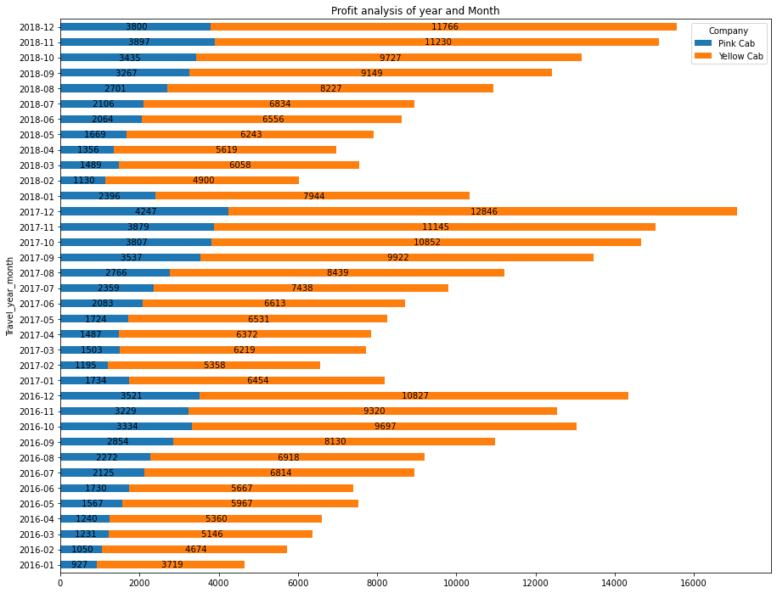
Profit Analysis of Year and Month
Both Companies has highest profit at the last month of the year (December)
Most of the users prefer in travelling with Yellow cab company
Pink cab company has the lowest number of users in through out the year. While, Yellow cab company has more customers in every month of year and double in the number of customers as compared to Pink cab company.

Slide 13
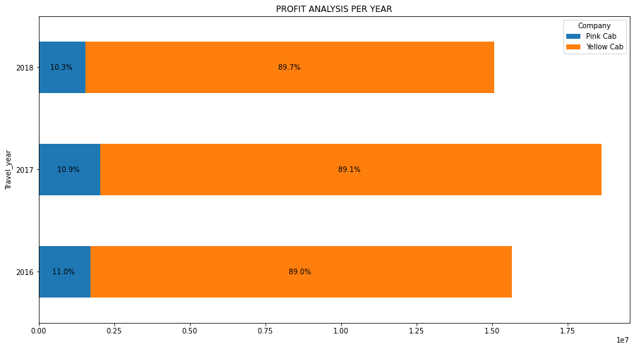
Profit Analysis in Year
Yellow cab company accumulates the 89% of the profit while the Pink cab company only accumulate the 19% of the total profit and has also lowest number of users

Slide 14
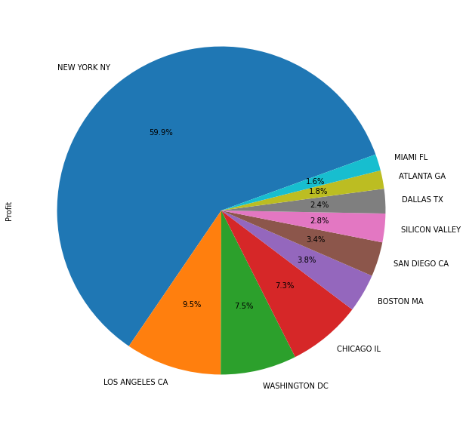
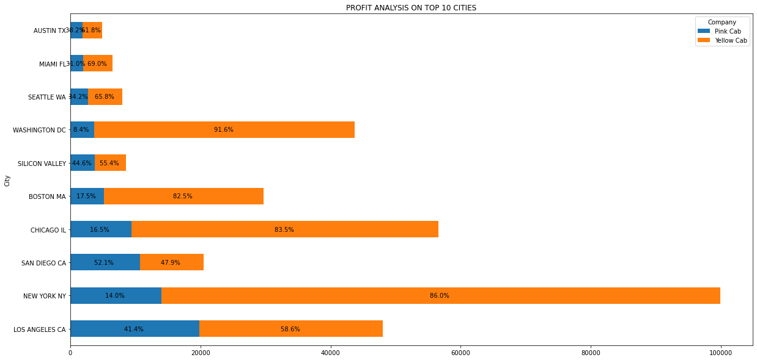
Profit Analysis in 10 Cities
The graph shows that the 10 cities with users and NYC accumulates the highest number of users which NYC is profitable city in all over the US for cab companies

Slide 15
Findings of EDA
Yellow Cab company is the most popular in the users.
Yellow cab company aggregates of 89% of profit per year as compared to nearly 12% of profit by Pink cab company
New York is the most preferable city of Cab users.
According to EDA, the Yellow cab company is most preferable option for investment.

